Slide 1
Network Attack Detection and Prevention using Snort, Grafana and Prometheus
Team : Four Unknown Signatures
Guide:
Prof. Sandeep Shukla
• Punit Chaudhari (21111050)
• Akshay Kumar Chittora (21111007)
• Jeet Sarangi (21111032)
• Piyush Gangle (21111046)

Slide 2
Problem Statement
During recent years, number of attacks on networks has dramatically increased and consequently interest in network intrusion detection has increased also the area of network traffic visualisation is of great importance since for monitoring of packets in a network can solve many of the issues in field of security.
Fully customizable environment makes things more efficient, Because the system that can be modified as per the requirement of an organization

Slide 3
Proposed Solution
The goal of our project is to detect intrusions like DDOS, TCP SYN flooding, ARP spoofing, Smurf DOS, Nmap port scanning, OS fingerprinting, etc. and trigger the counter measures based on the threat detected.
Based on threat detected, corresponding counter measure will be triggered in-order to bring down the system to a safe state.
Grafana visualization engine is hosted at the server that will monitor the behaviour of each agent and trigger alerts if any suspicious behavior is encountered.

Slide 4
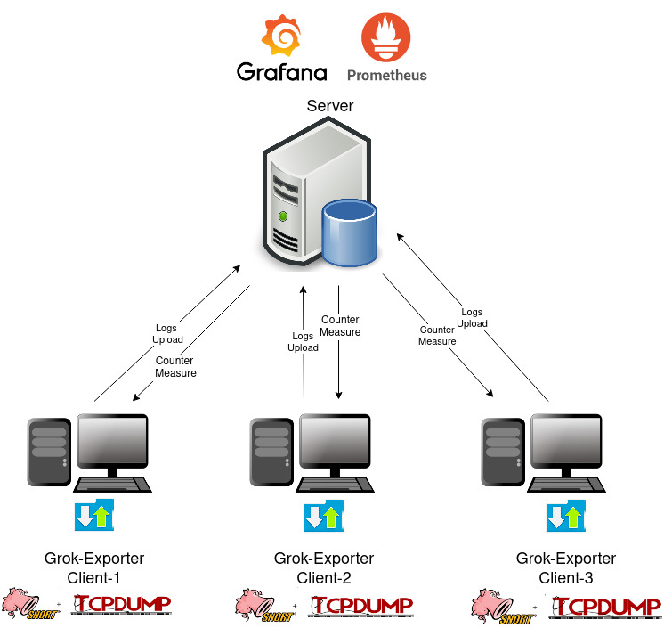
Architecture
Components of Server:
1.Grafana
2.Prometheus
Components of Agent
1.Grok-Exporter
2.Snort
3.TCPdump

Slide 5
Architecture Cont.
Role of Server:
Prometheus server will be connected to all the agents and it will collect logs from them at particular scrap interval(1s).
Prometheus will build a single data structure which will aggregate all the logs of every agent.
Grafana Visualization Engine is established at server and it will query the Prometheus with the help of PromQL(Prometheus Query Language) in-order to fetch the records and perform visualization.

Slide 6
Architecture Cont.
Role of Server:
Grafana Alert Notifications are used to generate an alert if any suspicious behaviour is encountered.
We have set certain thresholds like(tcp_packet count>1500) based on which alert will be generated.
Grafana will keep an eye on network packets if certain packet count goes beyond threshold then it will generate and send a alert message in JSON format to Webhook(at agent end)

Slide 7
Architecture Cont.
Role of Agent:
Snort and TCPdump will execute on agents, collect network activities and generate logs.
Grok-exporter will be running on each agent in-order to collect logs and send those to Prometheus server.
Client at agent side consisting of webhook will be listening at a defined port for Grafana Alert Notifications.
Counter-measure like(block ip, drop packets ,etc.) will be applied by the client for certain time duration with the help of firewall.

Slide 8
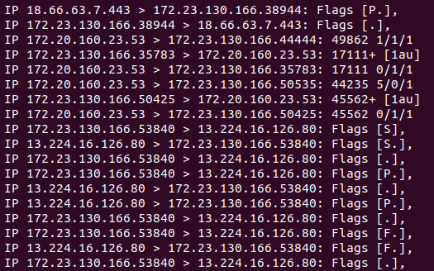
Log File Structure

Slide 9
Log File Preprocessing
Logs generated by TCPDUMP are preprocessed using a bash script.
Basically Bash script extracts the useful information(selected protocol packets are used in our case like arp,icmp,udp,tcp) from the log file and truncate the residual.
Script used is :

Slide 10
Prometheus Metrices
Prometheus has four kind metrics (Counter, Gauge, Histogram, Summary) to collect various kind of information from log file.
Counter: is used to count number network packets satisfying certain rule(example: count tcp packets, count icmp packets)
Gauge: is used to store numeric value for a certain attribute( ex. cpu utilization of a instance).

Slide 11
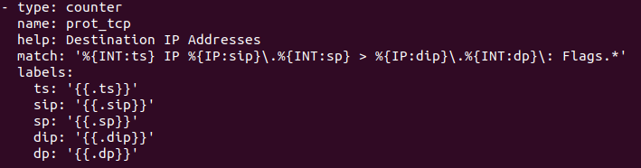
Counter Metric

Slide 12
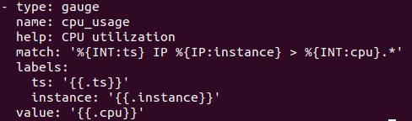
Gauge-Metric

Slide 13
Grok Patterns and Syntax
Grok uses regular expression or regex to match the patterns and extract information for each attribute.
Rule for matching TCP packet is illustrated in example below
Log instance which will have a match for above mentioned rule

Slide 14
PromQL
Prometheus provides a functional query language called PromQL (Prometheus Query Language) that lets the user select and aggregate time series data in real time.
Most frequently used function used in PromQL are count(),sum(),rate()..etc.
Example query to count number of tcp packets for each agent is
count(prot_tcp) by(instance)

Slide 15
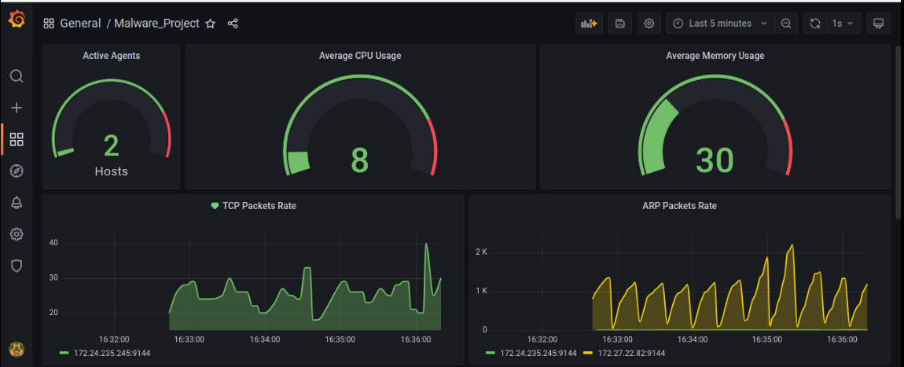
Grafana Dashboard

Slide 16
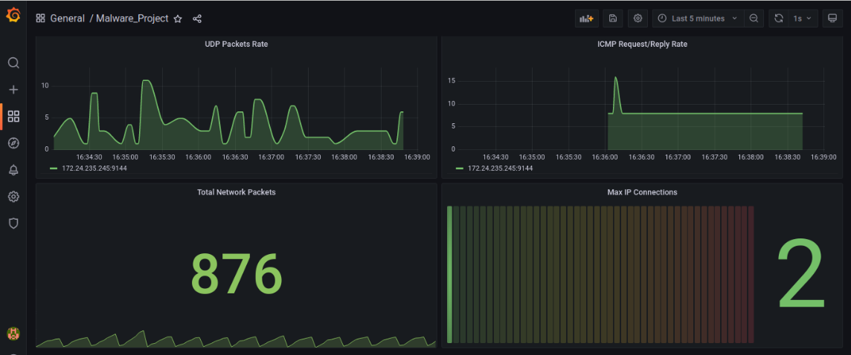
Grafana Dashboard cont.

Slide 17

Snort/ Tcpdump output processed using script
Netlog.txt
Prometheus
Targets and scrape interval defined.
Prometheus QL used to query data fetched from the clients.
Grafana to visualize
Active agents, tcp, udp, arp,icmp packets activities and also total metrics.
Grok exporter
extract out tcp,udp, icmp and arp packets.
IF
Grok
Alert generated
Grok
Agents will get alerted and in response the packets can be dropped or the IP can be blocked.

Slide 18
Demo
Link to demo
Alternate link

Slide 19
Limitations
Limited number of protocols are considered(tcp,udp,arp,icmp)
Machine Learning assisted threat detection can be incorporated
More security metrics can be added to make system robust.

Slide 20
Conclusion and Results
The proposed system can detect & prevent(applying counter measure) network intrusion attacks like DDoS,TCP flooding,ARP Spoofing,Nmap Scanning , etc.
Visual representation of the network state helps the administration to take action against vulnerability quicker.

Slide 21
Thank you

